Slide 1
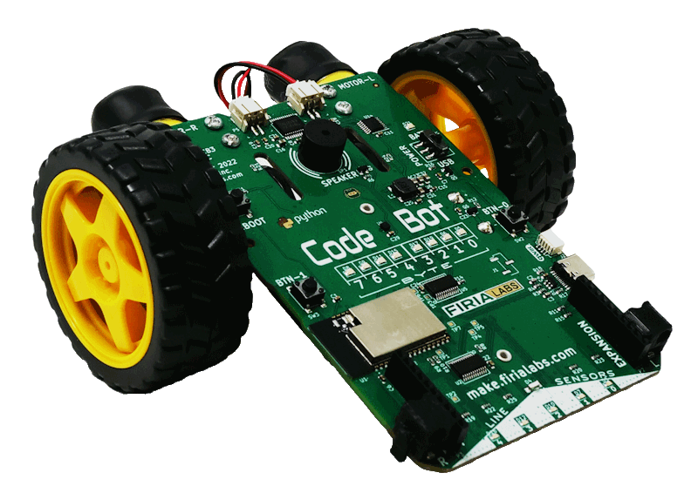
CodeBot Unit 3 Remix
Create your own project based on Mission 6 and 7

Slide 2

Time for a project remix!
A remix can be:
A new program created by adding new code to a program you already created
You can combine parts of two or more programs in a remix
Use a similar idea in a different way

Slide 3
Project Remix
Creating a remix will let you:
Improve your skills and practice the concepts from the mission.
Be creative.
Remember code from earlier programs and missions.
Work with other students.
Design an original program and write the code all on your own.

Slide 4
Step #1
Review Mission 6 and 7
Open your programs from Mission 6 and 7
  CheckLines
  LineFollow1
  HotPursuit
DO THIS:
Fill out the information in the Planning Guide for Step 1

Slide 5
Step #2
Brainstorm ideas
Read through the mission extension ideas.
Read through remix suggestions.
You can use any of these ideas, combine them, or come up with your own.

Slide 6
Step #2 Remix Ideas
Mission 6 Line Follower Extensions
Add a button to stop the ‘bot.
Add more sounds in the code. Play a sound when on the line, or a different sound when going off the line.
Light up user LEDs as a communication on what the ‘bot is doing.
Have a competition on a track to see who’s ‘bot gets to the finish line first. If it is yours, play a victory song and do a dance!

Slide 7
Step #2 Remix Ideas
Mission 7 Hot Pursuit Extensions
Add sound to the chase.
Add an animation. Keep track of the time. If the object hasn’t moved in 10 seconds, have the ‘bot perform an animation, like a puppy asking for the ball to be thrown.
Add an animation for when there is no object detected, like a puppy wanting to play.

Slide 8

Step #2 Remix Ideas
Mild
Combine Mission 6 and Mission 7 using the buttons: press 0 for line follower and 1 for hot pursuit.
Add sounds and actions to the fence patrol mission.
Medium
Add sounds and actions to the line follower or hot pursuit program.

Slide 9
Step #2 Remix Ideas
Spicy
Add sounds and actions to the line follower or hot pursuit program. Have more than one sound/action combination. Use a counter or random number to vary which sound/action combination is displayed.
Spicy
Start with a line follower program and then allow the ‘bot to be distracted by a detected object and go “off course.”

Slide 10
Step #2
Brainstorm ideas
Read through remix suggestions
Use the suggestions –or–
Use your creativity to come up with your own idea for a project
Decide with your partner what project you will do
DO THIS:
Fill out the information in the Planning Guide for Step #2

Slide 11
Step #3
Make a plan
What variables will you need? What will you use them for?
What will you program the buttons to do?
What will you use the user LEDs and line sensor LEDs for?
Will you use the speaker? If so, when?
How will you incorporate the line sensors or proximity sensors?
What are some functions you can define and use? Will they need parameters?

Slide 12
Step #3
Make a plan
DO THIS:
Fill out the information in the Planning Guide for Step #3
  Add to the Planning Guide with more information, as needed.
  NOTE: You can modify your plan as you begin to program. You may come across more functions to create, LED uses, variables, etc., as you go.
  You do not need to revise Step 3 while you work.

Slide 13
Step #3
Make a plan
DO THIS:
Use a piece of paper to write an algorithm for your project:
  What happens first?
  What happens next?
This algorithm will help you get started.
  What do you need to import?
  What variables will you define at the beginning of your code?
  Are there functions you can start with?
  What happens first in the main program?
  What will happen in the button presses?

Slide 14

Step #4
Code your project
IMPORTANT: In CodeSpace, go to the sandbox
Start a new file and give it a descriptive name (Remix3)
You can leave other programs open and use them as a guide
Import your modules
Define your variables
Write functions near the top of your code
Write function calls and other instructions in the main program
Write your code a little bit at a time, testing frequently

Slide 15
Step #4
Stop and test frequently!
Don’t try to write all the code at one time
Think about the steps:
  Just get one thing to work, then move on
  Step by step!
Mistakes happen, so find them early
Type just a few lines of code and then run the program
If there is an error, fix it before continuing
Use your other programs and classmates for help

Slide 16
Step #4
Documentation!
Make sure your code is readable by adding blank lines
Add comments to sections of your code that explain what they do

Slide 17
Step #5
Get feedback and Revise
Show your code to other students.
What do they think? Have them fill out the feedback form on your Planning Guide.
The Planning Guide has space for two people to give feedback. The feedback can come from two peers or one peer and yourself.
Use the peer reviews to modify your code and make your project even better

Slide 18

And now you have your own remix!
Congratulations!
By completing this remix you have:
learned more about programming
practiced the skills and concepts from the missions
been thinking! And problem solving and much more!

Slide 19

Mission Reflection
Wow! Great job!
Share your project with your friends!
Run projects from other students
Complete the Post-Remix Reflection in the Planning Guide

